Slide 1
Digital Electronics
Principles & Applications
Fifth Edition
Roger L. Tokheim
Chapter 6
Encoding, Decoding, and
Seven-Segment Displays
©1999 Glencoe/McGraw-Hill

Slide 2
CHAPTER 6 PREVIEW
The BCD Code
The Excess-3 Code
The Gray Code
The ASCII Code
Encoders
Seven-segment Displays
Seven-segment LED Displays
Decoders
BCD-to-Seven-Segment Decoder/ Driver
Liquid Crystal Displays
Vacuum Fluorescent Displays

Slide 3
THE 8421 BCD CODE
BCD stands for Binary-Coded Decimal.
A BCD number is a four-bit binary group that represents one of the ten decimal digits 0 through 9.
Example:
Decimal number 4926 4 9 2 6
8421 BCD coded number 0100 1001 0010 0110

Slide 4

TEST
Convert the BCD coded number
1000 0111 0001 into decimal.
BCD Coded Number 1000 0111 0001
Decimal Number 8 7 1

Slide 5
TEST
Convert the decimal number 350 to its BCD equivalent.
Decimal Number 3 5 0
BCD Coded Number 0011 0101 0000

Slide 6
THE EXCESS-3 CODE
Add 3 to each digit of decimal and convert to 4-bit binary form
A BCD code (not 8421 BCD)
Decimal Binary +3 Excess-3
0 0000 0011 0011
1 0001 0011 0100
2 0010 0011 0101
3 0011 0011 0110
4 0100 0011 0111
5 0101 0011 1000
6 0110 0011 1001
7 0111 0011 1010
8 1000 0011 1011
9 1001 0011 1100
Sample Problem:
Decimal 3 5 9
Excess-3 0110 1000 1100

Slide 7
THE GRAY CODE
The Gray code’s most important characteristic is that only one digit changes as you increment or decrement the count.
The Gray code is commonly associated with input/output devices such as an optical encoder of a shaft’s angular position.
The Gray code is NOT a BCD code.
Decimal Gray code
0 00000
1 00001
2 00011
3 00010
4 00110
5 00111
6 00101
7 00100
8 01100
9 01101
10 01111
11 01110
12 01010
13 01011
14 01001
15 01000
16 11000

Slide 8
THE ASCII CODE
ASCII is acronym for American Standard Code for Information Interchange
Represents numbers, letters, punctuation marks and control characters
Standard ASCII is a 7-bit code (127 characters)
Extended ASCII (IBM ASCII), an 8-bit code, is also very popular
Extended ASCII adds graphics and math symbols to code (total of 256 symbols)

Slide 9
ELECTRONIC ENCODER -
DECIMAL TO BCD
BCD output
Decimal input
0 0 0 0
0 1 0 1
0 1 1 1
0 0 1 1
7
Decimal
to
BCD
Encoder
5
3
0
Encoders are available in IC form.
This encoder translates from decimal input to BCD output.

Slide 10
SEVEN SEGMENT DISPLAYS
LED (light emitting diode) display
  Commonly red but available in other colors
  High power consumption
  Viewing best under low light conditions
LCD (liquid crystal display)
  Commonly dark characters on a silvery background
  Very low power consumption
  Viewing only OK in good light
  Backlighted displays can be viewed in low light
VF (vacuum fluorescent) display
  Commonly blue-green display (without filters)
  Medium power consumption
  Viewing good from dark to lighter conditions
  Based on vacuum tube triode technology

Slide 11
OPERATION OF A
7-SEGMENT LED DISPLAY
Inputs
7-segment code
a
Note that inputs are
“active-LOW”
H
L b
L c
H
H
H
H
7-segment display
reads decimal 1
(segments b & c
are lit)
b & c inputs active
therefore
segments b & c
light on display
+5V
g
Limiting resistors
Common anode
Cathode terminals (a thru g)
7-segment LED display
(common anode)

Slide 12
TEST
Q #2- What is the decimal output on the display for the new set of inputs?
Q #3- What is the decimal output on the display for the new set of inputs?
Q #4- What is the decimal output on the display for the new set of inputs?
Q #1- What will be the decimal output on the 7-segment LED display?
Inputs
7-segment code
a
L a
L b
L c
H
H
H
H
H
L b
L c
H
H
L f
L g
L a
L b
L c
L d
L e
L f
L g
L a
H
L c
L d
H
L f
L g
+5V
g

Slide 13
DECODERS: BCD TO
7-SEGMENT DECODER/DRIVER
BCD input
Decimal output
LED
0 0 0 0
0 0 0 1
0 0 1 0
0 0 1 1
0 1 0 0
BCD-to-
7-Segment
Decoder/
Driver
Electronic decoders are available in IC form.
This decoder translates from BCD to decimal.
Decimals are shown on an 7-segment LED display.
This IC also drives the 7-segment LED display.

Slide 14
TEST
Q #1- What is the decimal output from the decoder that
appears on the 7-segment display?
Q #2- What is the decimal output from the decoder that
appears on the 7-segment display?
Q #3- What is the decimal output from the decoder that
appears on the 7-segment display?
Q #4- What is the decimal output from the decoder that
appears on the 7-segment display?
Q #5- What is the decimal output from the decoder that
appears on the 7-segment display?
Answer: 3
Answer: 0
Answer: 9
Answer: 7
Answer: 6
BCD input
Decimal output
1 0 0 1
0 1 1 1
0 0 0 0
0 1 1 0
0 0 1 1
BCD-to-
7-Segment
Decoder/
Driver
?

Slide 15
LIQUID-CRYSTAL DISPLAYS
LCDs control available light (do not generate light)
Nematic fluid (also called liquid crystal fluid) is sandwiched between two glass plates
Monochrome field-effect LCDs display dark figures on a silvery background.
LCDs are commonly used on watches, calculators, and laptops. LCD monitors are available.
Color LCDs use either passive-matrix or active-matrix technology.
Active-matrix color LCD screens are more expensive.
Most laptop screens are backlighted for brightness.

Slide 16
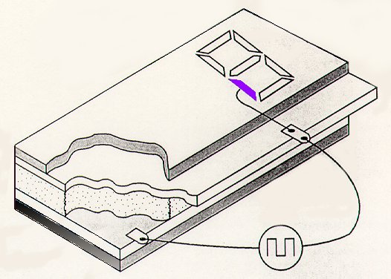
LIQUID CRYSTAL DISPLAY
Metalized segments
Polarizer
Conductive
pattern on glass
Contacts
Liquid crystal
Metalized layer
Glass backplane
100 Hz
out-of-phase signal
activates segment
Polarizer

Slide 17
DRIVING AN LCD DISPLAY
BCD Input
0 1 1 1
a
b
c
LCD
driver
d
e
f
g
Phase
Common
The LCD segments
with out-of-phase signals
are active
(a, b, & c are active)
100 Hz Clock

Slide 18
VACUUM
FLUORESCENT DISPLAYS
VF displays are commonly used in automobiles because they operate at the proper voltages, have a pleasing blue-green color, are easy to see even when viewed under lower light conditions, and will operate at wide extremes of temperature.
VF displays are based on an older triode vacuum tube technology.
VF displays are also commonly used in point-of-sale terminals and some desktop calculators.

Slide 19
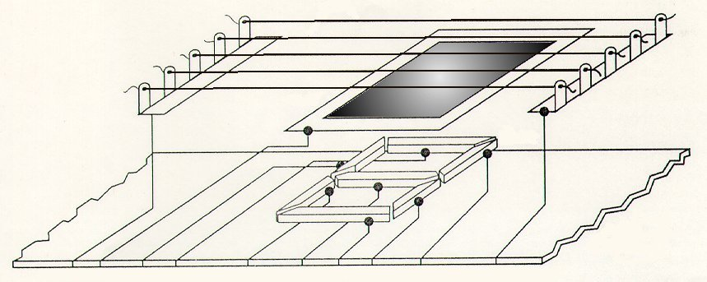
VACUUM
FLUORESCENT DISPLAY
Cathodes (heaters)
Grid
K G f a e g d c b K
Glass
back
Plates

Slide 20
OPERATING A VF SEVEN-SEGMENT DISPLAY
+12 V
0 V
Plates
Plates
Plates
Plates
P_{a}
P_{b}
P_{c}
P_{d}
P_{e}
P_{f}
P_{g}
+12 V
To light a segment:
1. Heaters must be hot
2. Grid must be at +12V
3. Plate must be at +12V
Cathodes
(heaters)
Cathodes
(heaters)
Cathodes
(heaters)
Cathodes
(heaters)
Grid
Grid
Grid
Grid

